Slide 1
Chapter 3
Achieving Mental and Emotional Health

Slide 2
Lesson 1 Developing your Self-Esteem
Mental and Emotional Health - The ability to accept yourself and others, express and manage emotions and deal with the demands and challenges you meet in your life.
Resilient – the ability to adapt effectively and recover from disappointment, difficulty, or crisis.

Slide 3
Characteristics of Good Mental and Emotional Health
Sense of belonging
Positive outlook
Sense of purpose
Self-sufficiency
Health self-esteem

Slide 4
Self-esteem – how much you value, respect, and feel confident about yourself
Competence – having enough skills to do something

Slide 5
How to develop Self-esteem
When being praised for doing something well
Being reassured and take advice when doing tasks not mastered
Believing you can succeed
When mastering a new challenge
Looking at the reason you did not succeed and what needs to be done next time
How a person reacts emotionally to a situation when they do not succeed

Slide 6
Improving Self-esteem
Choose friends who value and respect you
Focus on positive aspects of yourself
Work towards accomplishments
Try new activities
Volunteer your time to help others

Slide 7
Developing self-awareness
Hierarchy of needs – ranked list of needs essential to human growth and development
Self-actualization – to strive to be the best you can

Slide 8
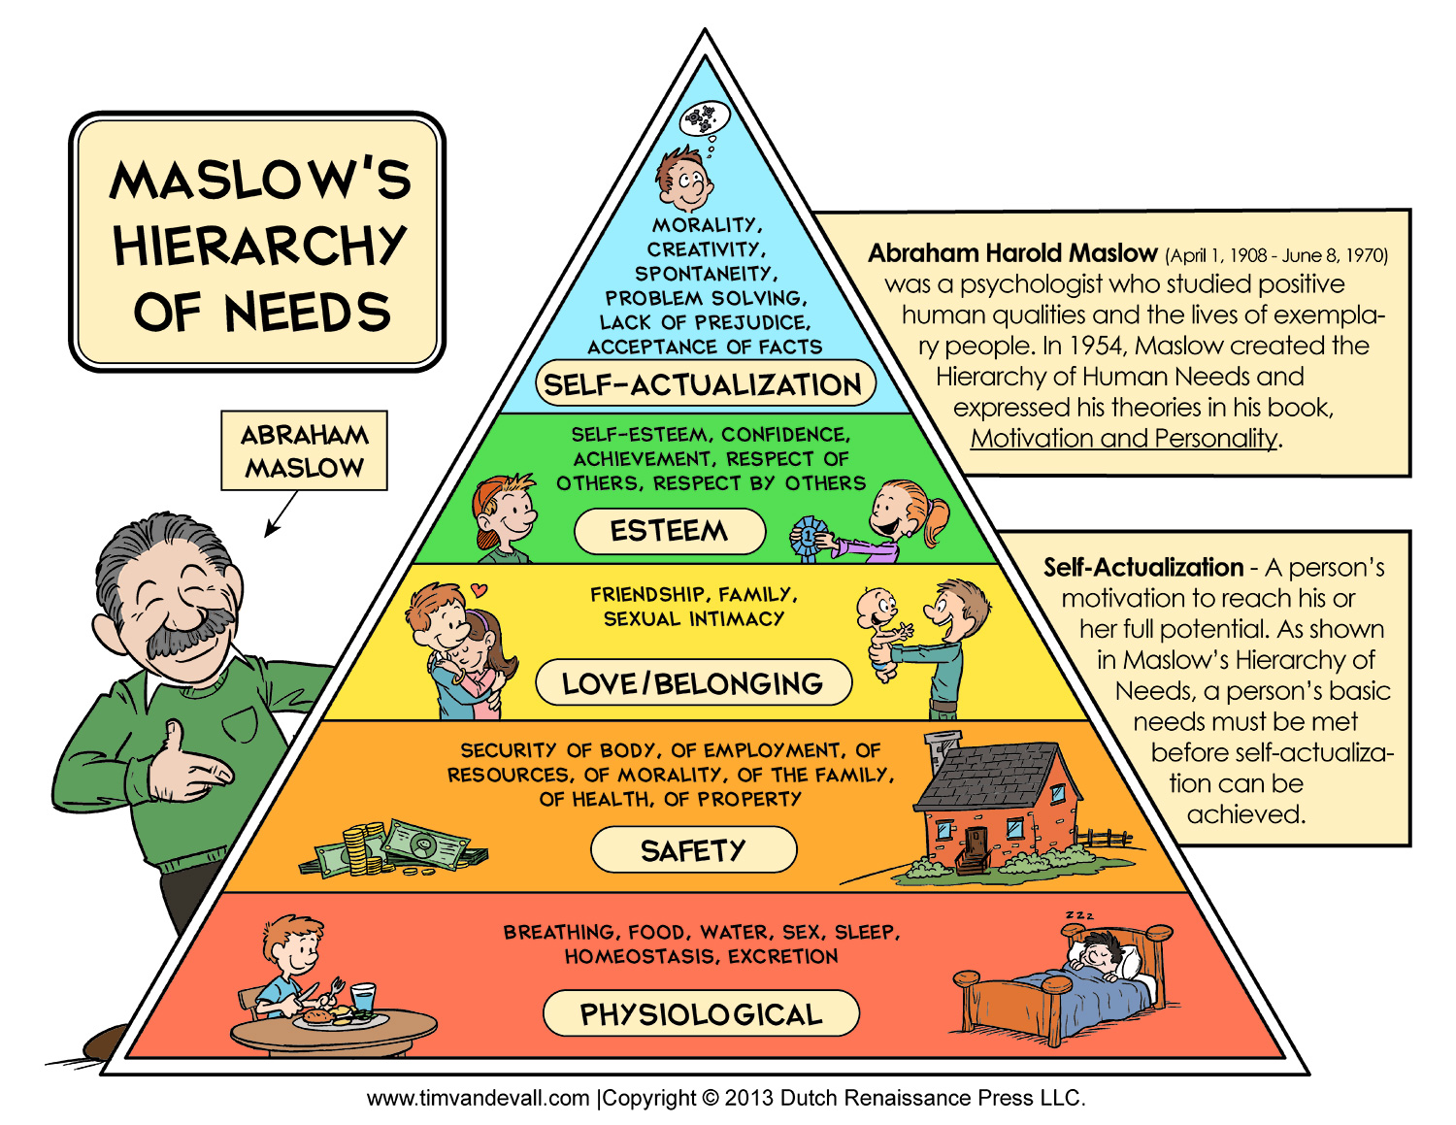
Hierarchy of Needs from Dr. Maslow

Slide 9
Lesson 2 – Developing Personal identity and character
Personal identity – the sense of yourself as a unique individual
Role model – Someone whose success and behavior serves as an example to others
Personality – a complex set of characteristics that makes a person unique
Character – The distinctive qualities that describe how a person thinks, feels, and behaves

Slide 10
Traits of good character
Trustworthiness
Respect
Responsibility
Fairness
Caring
Citizenship

Slide 11
Lesson 3 Expressing emotions in healthy ways
Emotions – Signals that tell your mind and body how to react
Hormones – Chemicals produced by your glands that regulate activities of different body cells
Hostility – Intentional use of unfriendly or offensive behavior

Slide 12
Managing your emotions
Empathy – The ability to imagine and understand how someone else feels

Slide 13
Responding to Difficult emptions
Defense Mechanisms – Mental process that protect individuals from strong or stressful emotions or situations
Common Defense Mechanisms
Repression
Regression
Denial
Projection
Suppression
Rationalization
Compensations

Slide 14
Anger Management
Dealing with guilt
Managing anger
Do something to relax
Channel your energy in a different direction
Talk with someone you trust

